Slide 1
Banking Marketing Analysis
Erin Huang, Deepankar Singh, Mengying Sun, Hemanya Tyagi, Juily Vasandani
(Team One)

Slide 2
Table Of Contents
Business Insight
Exploratory Analysis
Data Cleaning to prepare for Machine Learning
Machine Learning and Model Building

Slide 3
Business Insight
In the current context of our rapidly-evolving technological landscape, traditional marketing methods have been decreasing in popularity, shifting instead towards campaigns designed for the digital space. However, financial institutions still largely rely on telephone campaigns due to higher costs, larger competition, and the oversaturation of the market.
In this case, we used a data procured from a direct marketing campaign run by a Portuguese bank regarding a marketing campaign that attempted to persuade clients to subscribe to a term deposit. Our goal was to determine which factors contribute to the success of these campaigns and to build a model to predict the outcome of future campaigns.
Notes:
A Term Deposit is a deposit that a bank or a financial institution offers with a fixed rate (often better than just opening deposit account) in which your money will be returned back at a specific maturity time.

Slide 4
Introducing the data
Number of Observations: 41,188 instances collected
Client Demographics: age, job, marital status, educational background, current employment status
Financial Information: loan default status, housing loan, other loans
Campaign Information: contact time, duration of contact, number of times contacted, outcome of previous campaigns
Campaign Outcome

Slide 5
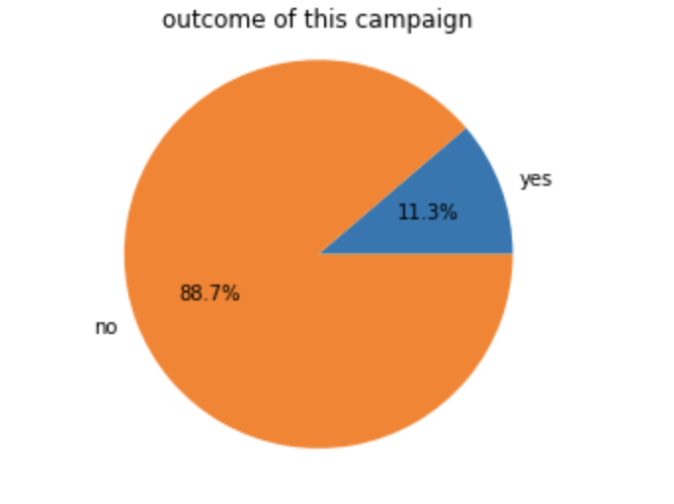
Exploratory Analysis: Outcome
The summary of results for the canpaign is highlighted in this chart.
Overall success rate: 11.3%
Given the low costs of direct marketing campaigns, a rate of approximately 10% is not bad. Further research would determine whether this is the most effective marketing strategy considering their budget and other factors.
Notes:
This outcome is not bad given the low cost of traditional phone campaign. Individual organization could decide whether this way of marketing is worth the money for them with their budget and the cost of other ways of advertising.

Slide 6
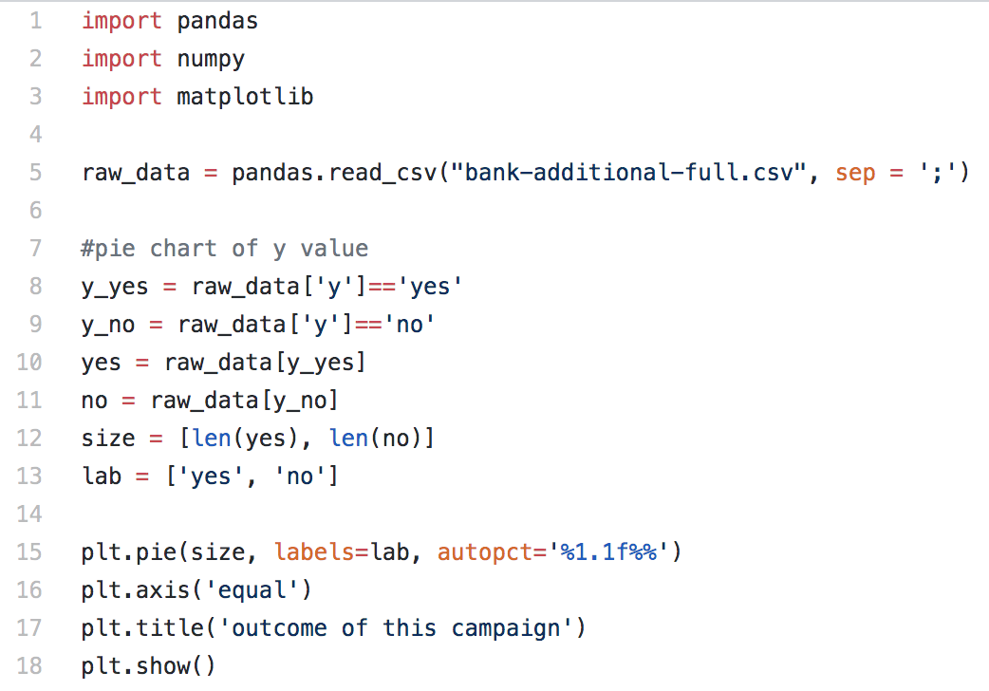
Working Code

Slide 7
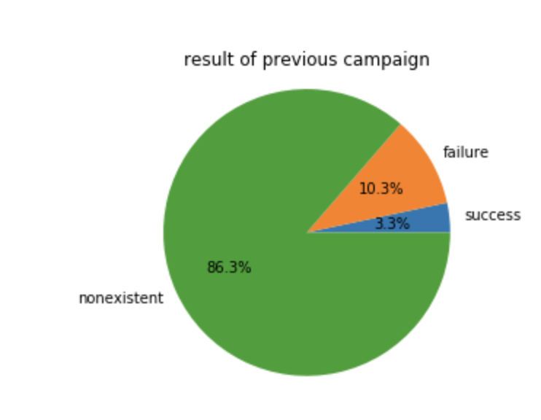
Exploratory Analysis: Previous Outcome
Business Question: Are we targeting a new market?
This distribution of clients shows whether or not they have been exposed to a previous campaign.
86.3% of clients were previously uncontacted
10.3% had not subscribed
3.3% chose to subscribe during the last campaign

Slide 8
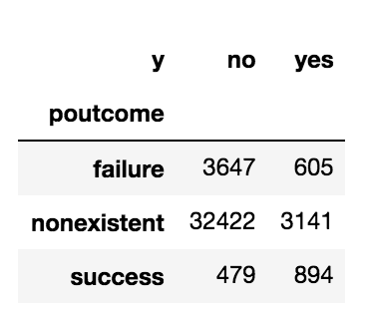
Exploratory Analysis: Outcome Comparisons
Business Question: How successful are our client conversions?
The cross tabulation was built to compare the two campaigns:
14.2% of clients who rejected the previous campaign were successfully converted
8.8% of uncontacted clients chose to subscribe to a deposit
65.1% of past successes also subscribed to this one
Notes:
Total clients who said ‘no’ in previous campaign: 4252
Total previously uncontacted clients: 35563
Total clients who said ‘yes’ in previous campaign: 1373

Slide 9
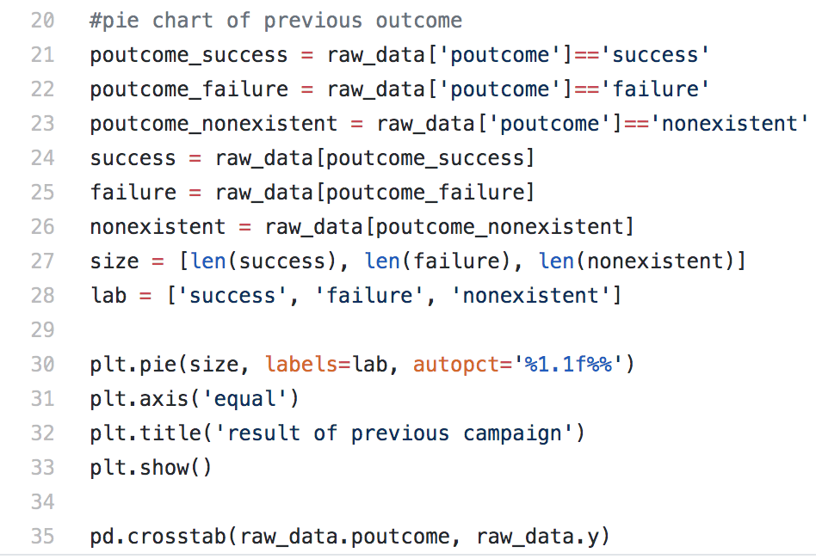
Working Code

Slide 10
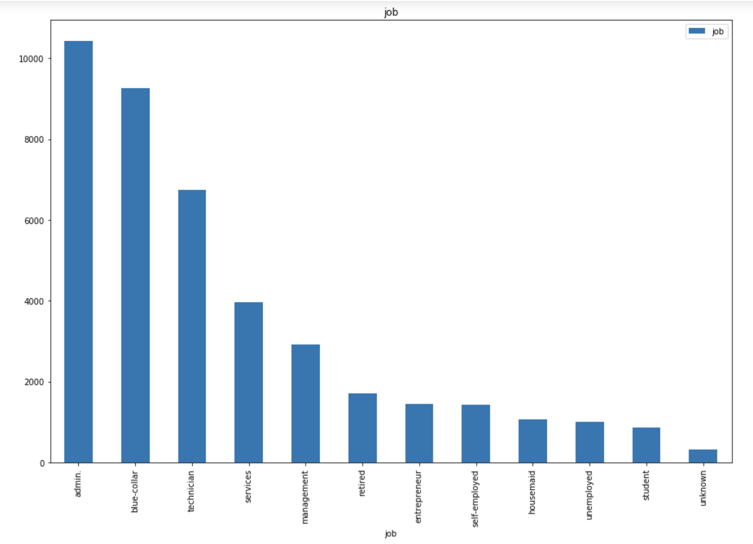
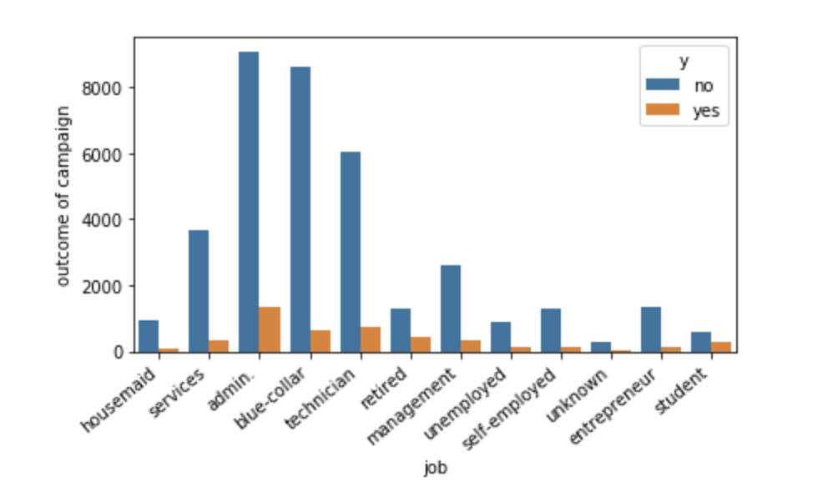
Exploratory Analysis: Employment vs. Outcome
Business Question: Which job category shows the highest number of successes and which shows highest success rate? Are they different?

Slide 11
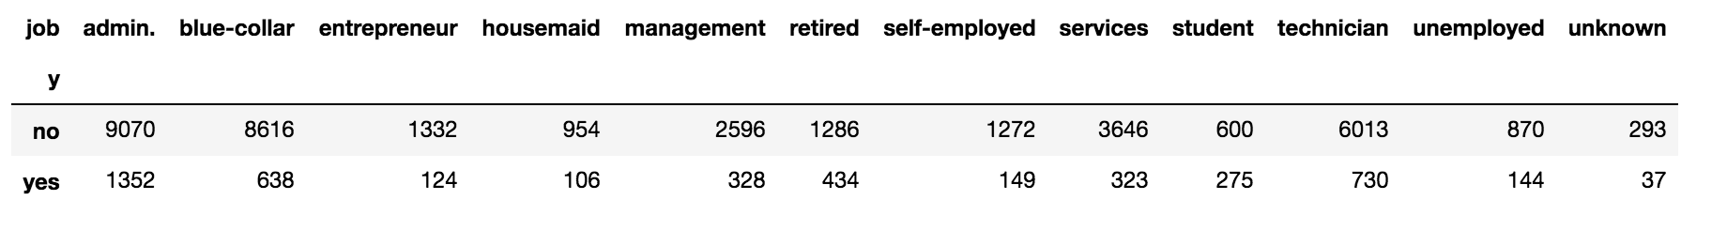
Exploratory Analysis: Employment vs. Outcome
Business Question: How can we use this information to improve future campaigns?
The majority of successes occur within the administrative group - a sensible target market for the bank since individuals within this category have higher incomes and are in need of financial services. However, success rates are highest with:
Students: 31.4%
Retired: 25.2%
The bank may factor in that admin clients may have wealth management agents while students and retired clients will need financial services but may not be able to afford personal agents.

Slide 12
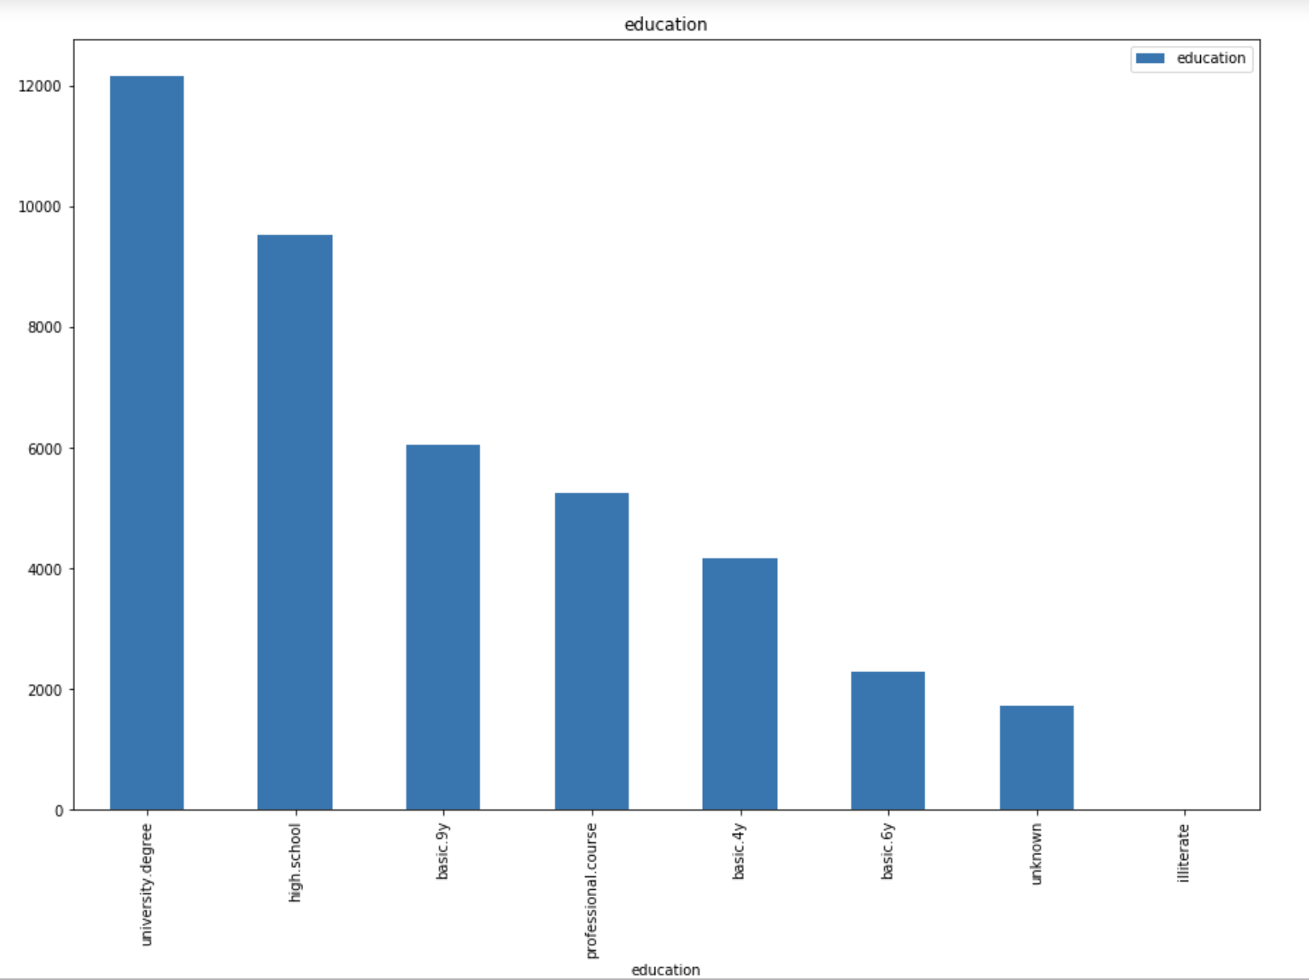
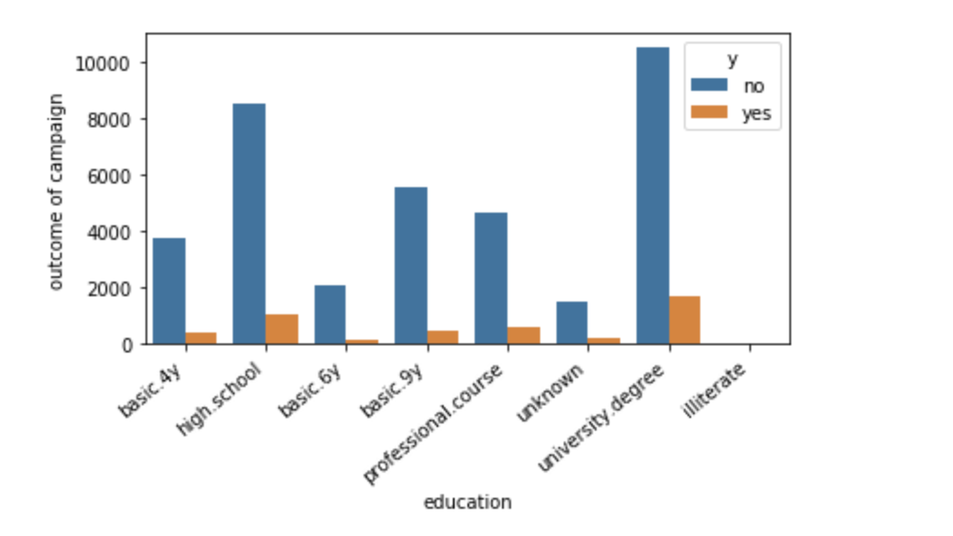
Exploratory Analysis: Education vs. Outcome
Business Question: Which education types are the most successful to sell to?

Slide 13
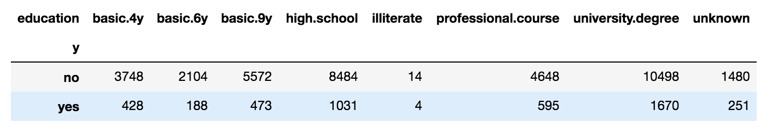
Exploratory Analysis: Education vs. Outcome
Business Question: Is the bank targeting the right demographic?
A majority of the targeted clients have a university degree. We can also see that clients with university degrees have a higher success rate - 13.7% compared to an overall success rate of 11.3%.
This could be because higher income levels are associated with individuals that have completed their degrees, allowing them to afford the bank’s services.

Slide 14
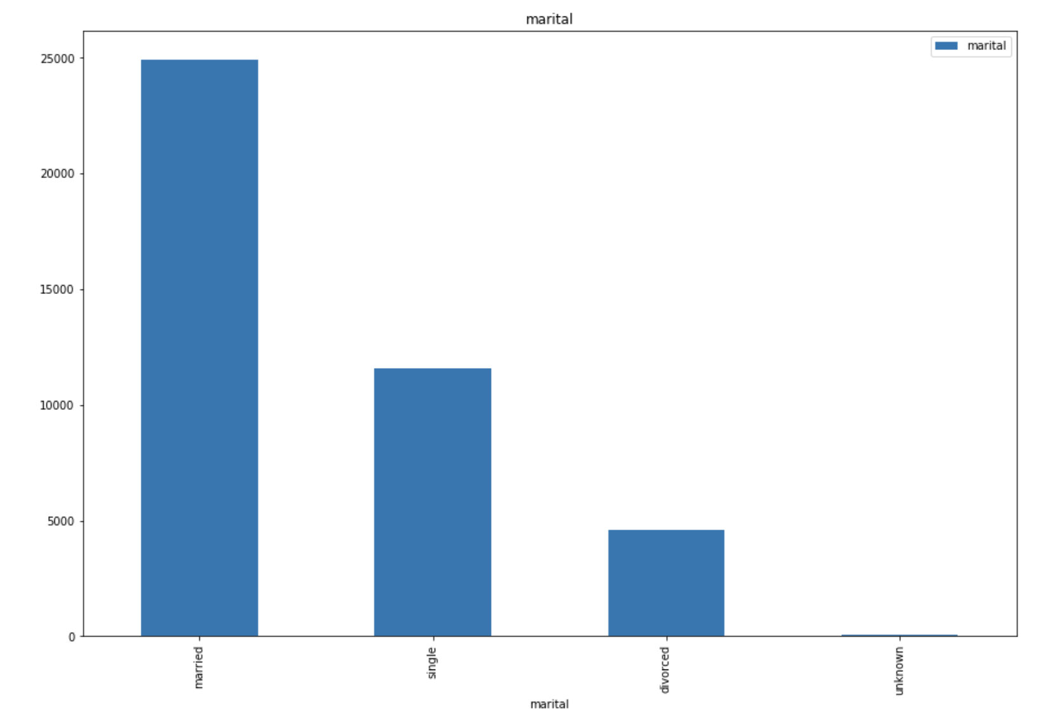
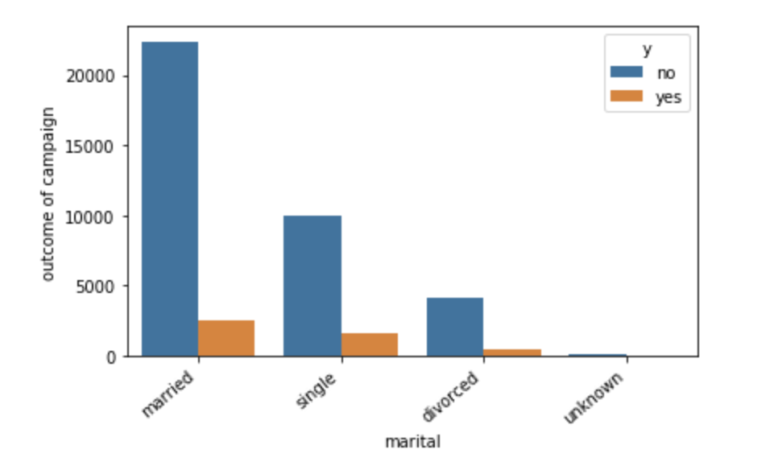
Exploratory Analysis: Marital Status vs. Outcome
Business Question: Does marital status impact the outcome of the campaign?

Slide 15
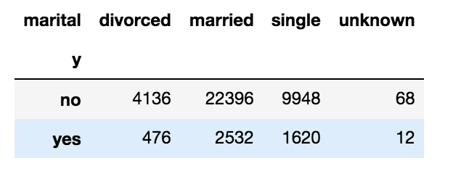
Exploratory Analysis: Marital Status vs. Outcome
Business Question: Does success rate vary between groups with different marital status? Does this change the bank’s targeting strategy?
Most of the clients are married, however, they do not have the highest success rate:
Married clients: 10.2%
Divorced clients: 10.3%
Single clients: 14%

Slide 16
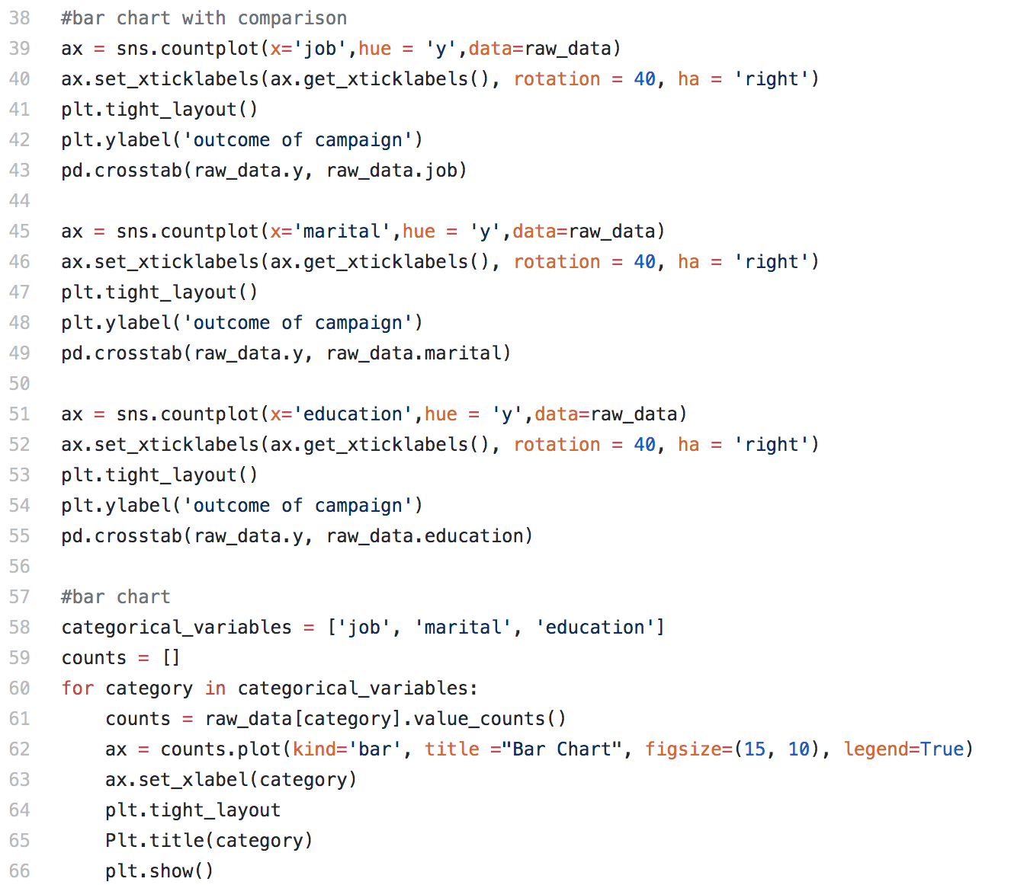
Working Code

Slide 17
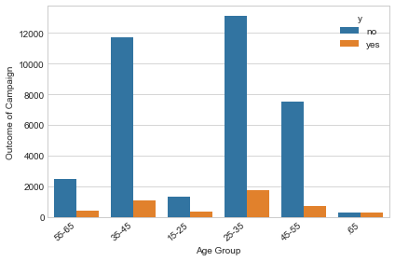
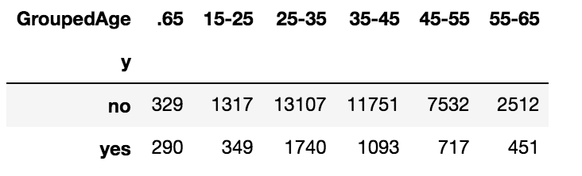
Exploratory Analysis: Age vs. Outcome
Business Question: Does age play a role in the outcome of the campaign?
Most clients are aged between 25-35. However, their success rate is only about 11.7%. Higher success rates are observed at:
15.2% for 55-65 year olds
46.8% for those 65+

Slide 18
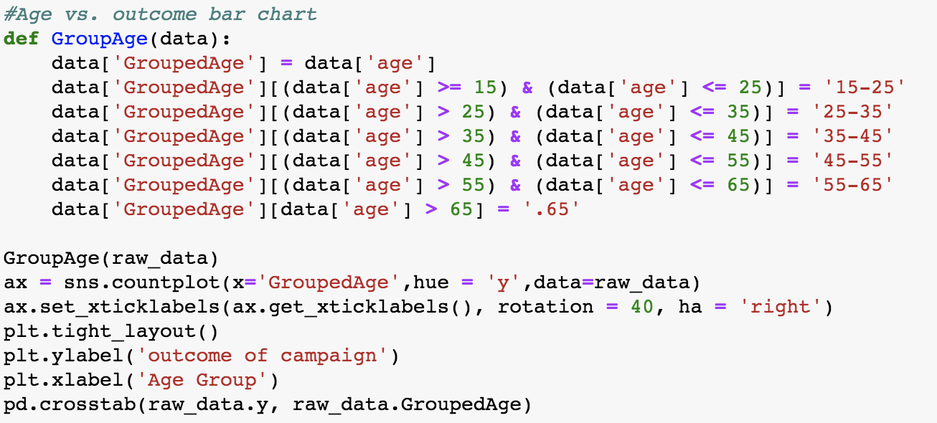
Working Code

Slide 19
What we’ve learned
The bank’s target market is highly skewed toward clients with certain characteristics (individuals with an administrative job, those who are married, and those with university degrees)
Certain client group that the bank did not focus on have great potential to commit to the bank’s services (students, retired clients, and singles)
A deeper analysis of client groups and their needs juxtaposed against their available services and how it fits to different groups of clients can help improve the bank’s success rate for future campaigns

Slide 20
Issues with Data Cleaning
Imputation: ‘Unknown’ value for some categorical variables
The variables: job, education, housing and loan had the highest ratio of unknown values, hence imputation is being done for those
For the model to take categorical variables, they have to be turned into dummy variables
We also had to deal with grouping certain variables for each of modeling and drop irrelevant variables

Slide 21
Solutions to Issues with Data Cleaning
Imputation
Based on given data, unknown job values for people with age > 60, these values have been replaced with ‘retired’
We assumed that education, jobs, loan and housing have a dependency on each other and so, using cross tabulation, we imputed these values
For example, using available data we got the probabilities of each housing category for each job category, and used random.choices() to allow the values to be imputed based on the already present distribution. We then replicated the same process for education and loan with respect to jobs variable

Slide 22
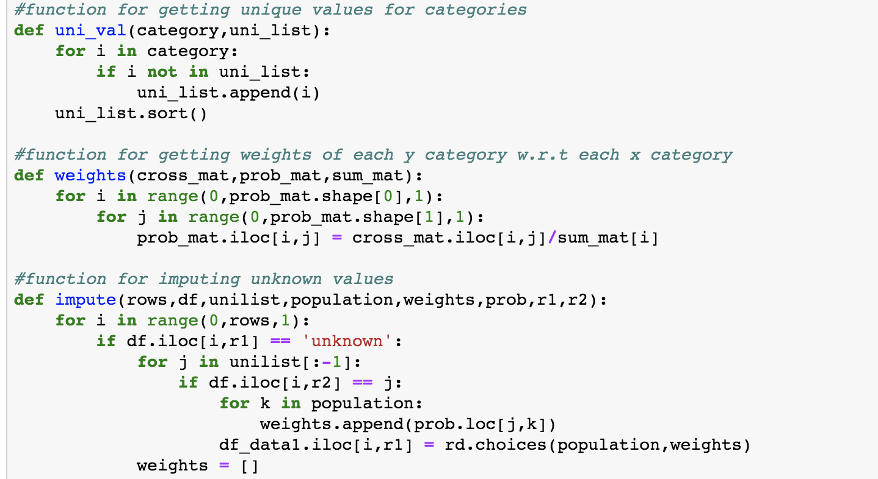
Code for Missing Value Imputation

Slide 23
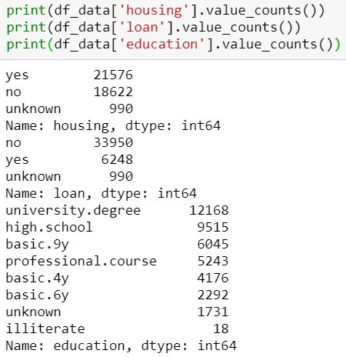
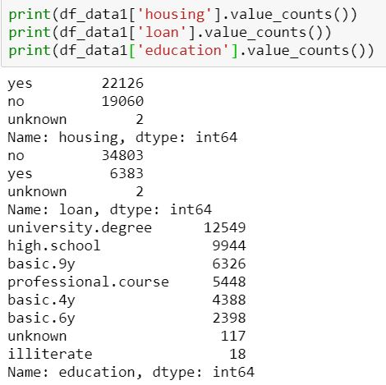
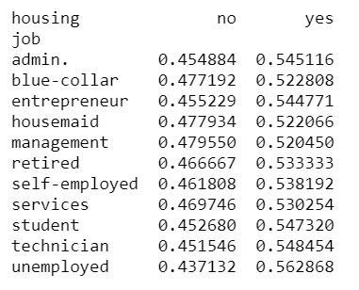
Code Outputs
Cross tabulation with weights for jobs vs. housing
Initial unknown values for housing, loan, and education
Final unknown values for housing, loan, and education

Slide 24
Solutions to Issues with Data Cleaning
Data Transformation
We converted the categorical variables into dummy variables for modeling. Created a new function as OneHotEncoder class returns a sparse matrix
Grouped months into quarters, and difference in duration between the previous and present contact into feasible groups - not contacted, less than 5 days, etc.
Binary encoded variables like housing, loan and y
Dropped Variables: duration, default. Since duration variable only gets a value when we have the output variable, it was dropped. Default was dropped due to the high number of unknown and “no” values and practically no “yes” value

Slide 25
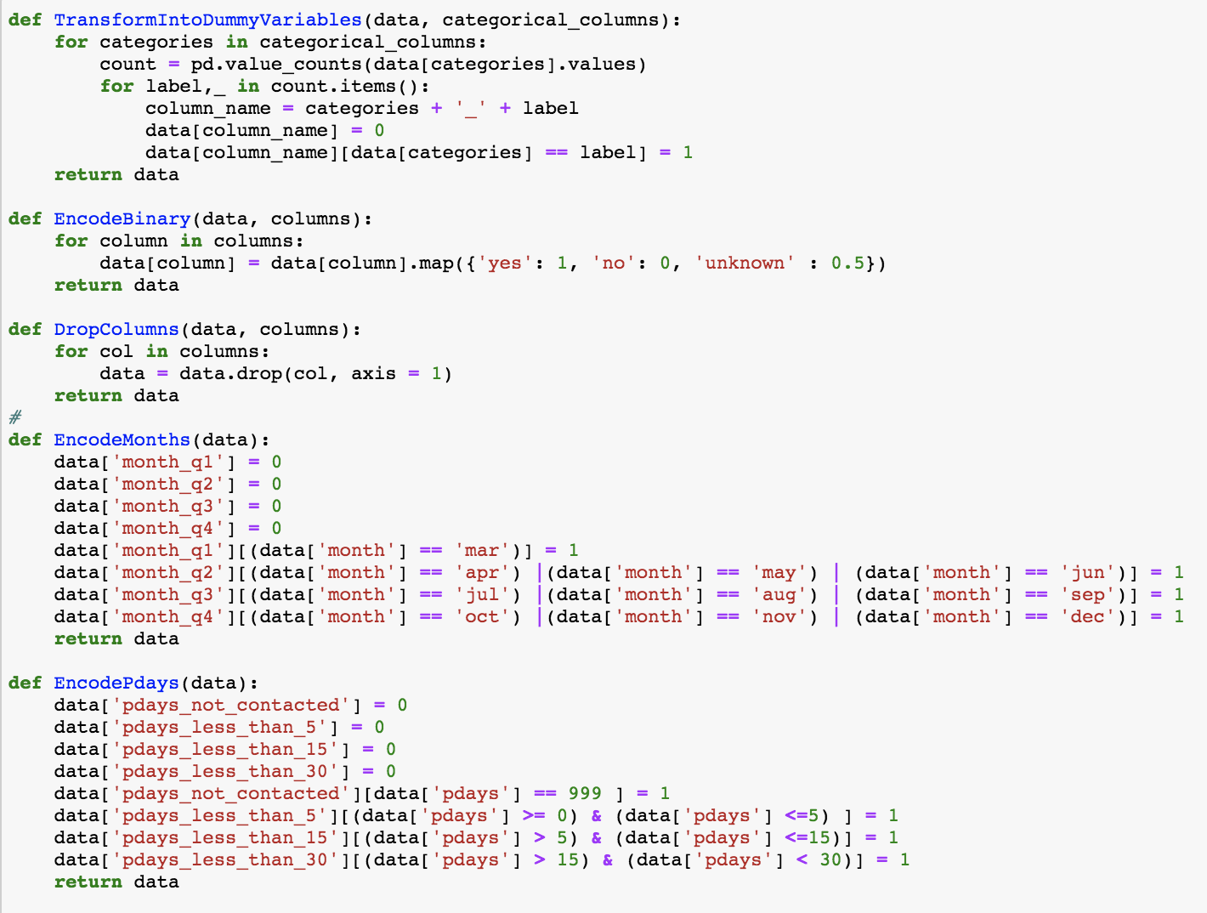
Code for Data Transformation

Slide 26
Solutions to Issues with Data Cleaning
Scaling
Used Min-Max Scaler to scale the numerical data such as age, campaign, etc.
Scaling used to standardize the distributions of numerical data

Slide 27
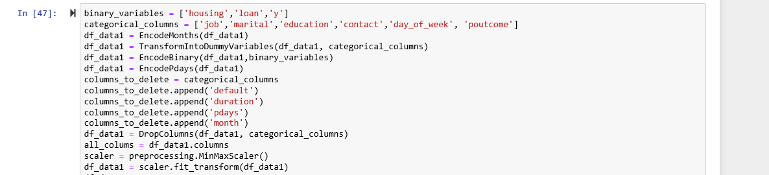
Pre-Processing Overview

Slide 28
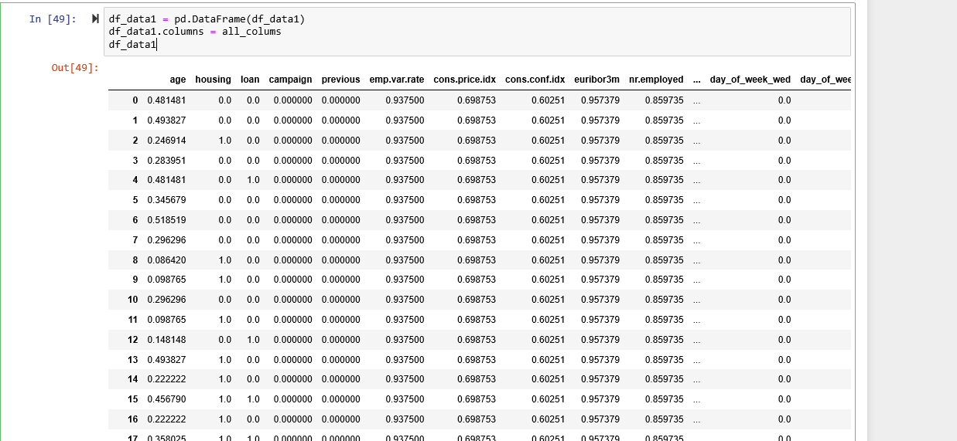
Pre-Processing Overview

Slide 29
Machine Learning
Initially used Decision Trees to classify with an accuracy of ~ 84%
Improved the accuracy using Random Forest (Bagging), increasing accuracy to ~ 89%
Further improved the algorithm by introducing Gradient Boosting, allowing accuracy to reach ~ 90%
Finally, performed 10-fold Cross Validation to avoid overfitting

Slide 30
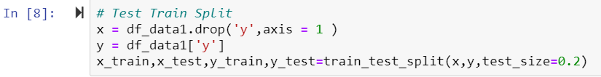
Test-Train Split
Train test divided into 80:20 ratio

Slide 31
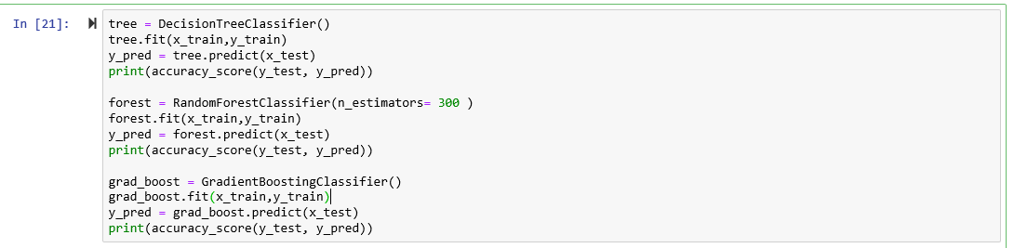
Machine Learning Models

Slide 32
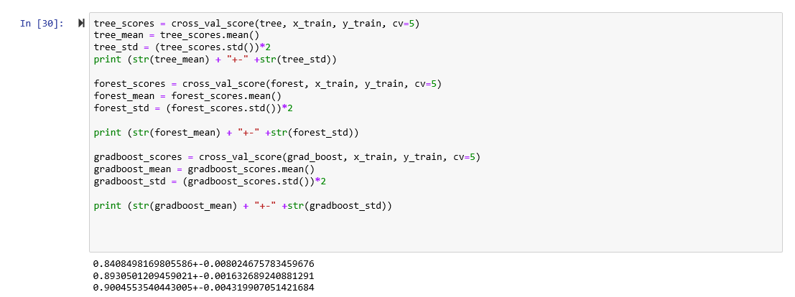
Cross-Validation

Slide 33
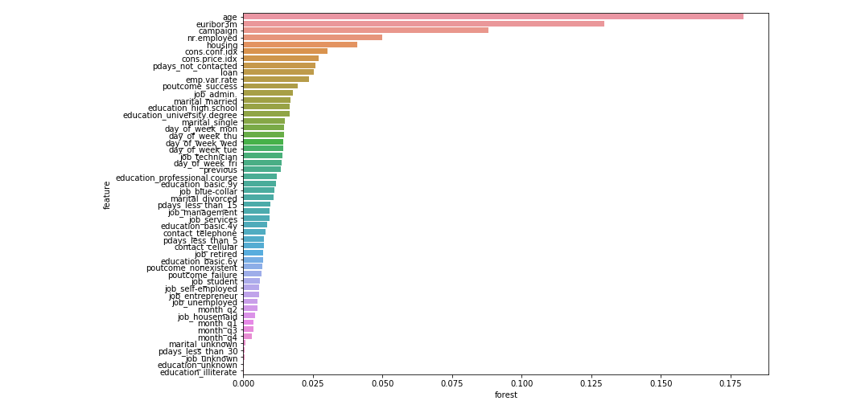
Important Features (Random Forest Model)

Slide 34
Important Features
The most important business decision: What are the factors we need to consider while conducting a marketing campaign to make more people subscribe to a bank’s term deposits?
Age
Euribor3m
Campaign
Nr.employed (Gradient Boosting Classifier tags this as the most important feature)
Cons.conf.idx

Slide 35
Thank You!

